Slide 1

Hybrid-Multi Cloud Demonstration — Deron Ringen Infrastructure Architect

Slide 2
A Demonstration of the Power that a Hybrid-Multi Cloud Solution can bring to a Kubernetes Environment

Slide 3
Quick Hi-Level Kubernetes Overview
Kubernetes is an open-source container-orchestration system. The containers are based on Docker images.
Components –
Kubernetes Master & Worker Nodes make up a cluster.
Kubernetes Master Nodes
Control the cluster
Kubernetes Worker Nodes
Run the docker images
Pod ~ services / functions

Slide 4
Hybrid-Multi Cloud Demo Overview
Design Goals -
Workloads (i.e. services / functions) can run anywhere where needed.
A running workload can quickly be moved to new location.
No “lock-in” to a specific cloud vender.
Solution -
Kubernetes Master and Worker Nodes Running the two data centers.
Kubernetes Worker Nodes Running in AWS and Azure.
Kubernetes Worker Nodes Running in AWS and Azure.
SD-WAN Solution Running at all locations.

Slide 5
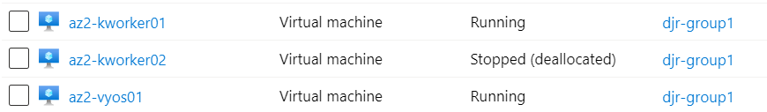
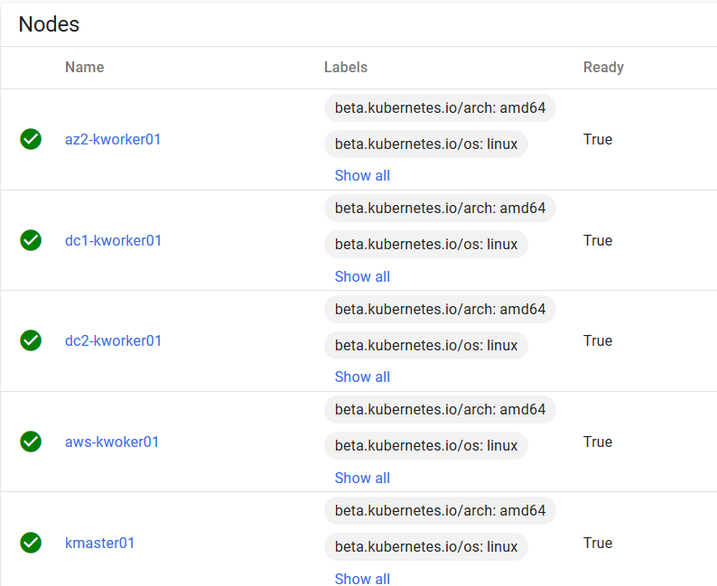
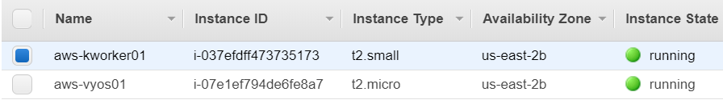
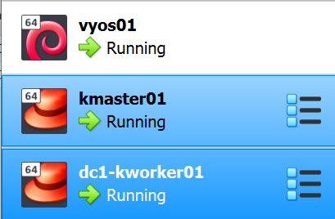
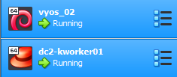
Hybrid-Multi Cloud Demo VMs & Kubernetes Nodes
Azure VMs
Kubernetes Nodes
AWS VMs
Data Center VMs

Slide 6
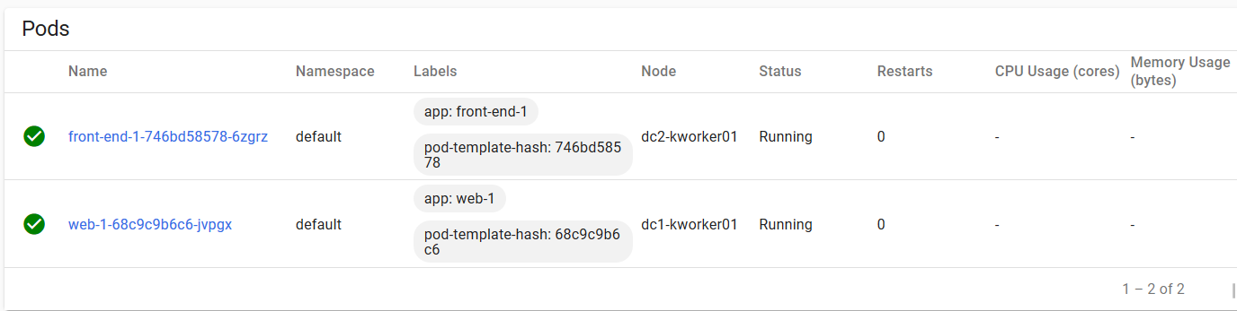


Demo 1 – Moving a Running Workload Kubernetes workload “web-1” running in Datacenter “dc-1”

Slide 7

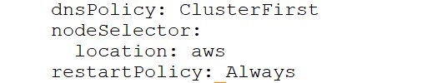
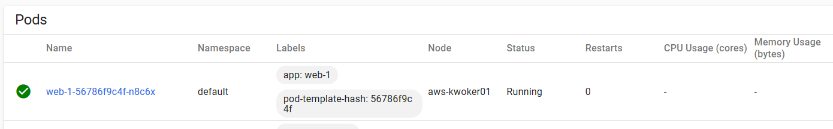



Modify workload “web-1” to run in AWS
Edit the “web-1” Kubernetes deployment & change the location to “aws”
Note; “location” is just a deployment specific label that I created and applied to nodes.
A few seconds later “web-1” is running on an AWS Kubernetes node

Slide 8
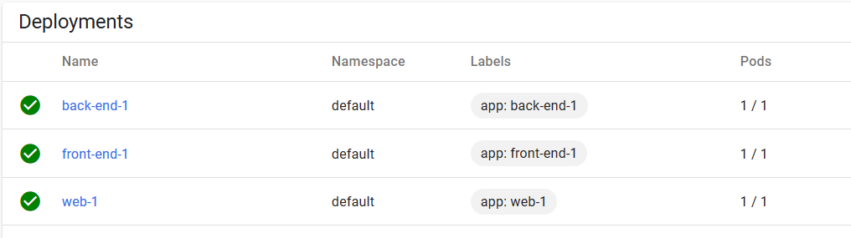
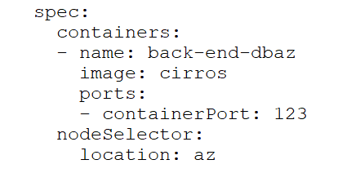

Demo 2 – Leverage a Cloud Based Service Create a new “back-end” to leverage a storage service in Azure
Current Kubernetes running deployments are:
Create “yaml” for new database deployment with “location” set to “az”

Slide 9

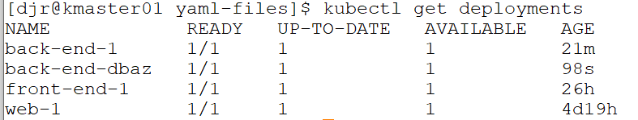
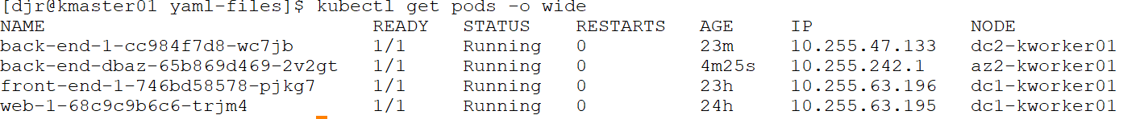




Create a new “back-end” to leverage a database service in Azure cont..
Apply the deployment yaml
Verify the “back-end-dbaz” deployment is running
Verify the location of “back-end-dbaz” pod

Slide 10
That was the “what” Now for the “how?”

Slide 11
Data Center “dc1” and “dc2”
Components -
Hypervisor (of your choice) or Physical Nodes
Kubernetes Nodes
- Virtual Box VMs
- VMs running CentOS 7
- Kubernetes manually loaded via custom script.
- Calico Networking Plug-in
SD-WAN Router (of your choice)
- VYOS
- Mesh of IPSEC tunnels to other location
- BGP ASN BR for each location
- The SD-WAN solution should be available for deployment at the datacenter as well as the chosen cloud providers.

Slide 12
Azure and AWS
Components -
VNET / VPC Created for VMs
Kubernetes Nodes
- Marketplace VMs running CentOS 7
- Kubernetes manually loaded via custom script.
Same Kubernetes install script used everywhere.
NOT using Azure / AWS Kubernetes.
- To spin up a new VM, install Kubernetes and
add it to the cluster takes ~15 - 20 minutes.
SD-WAN Router
- Marketplace VYOS
- Mesh of IPSEC tunnels to other locations
- BGP ASN BR for each location

Slide 13
Kubernetes Worker Node Installation Setup
Steps to Install and Add a Worker Node to a Kubernetes Cluster -
Spin up a CentOS 7 WM (Can be any distro of Linux)
Install Kubernetes (Kubernetes installs Docker)
Add worker node to the Kubernetes cluster (Calico added)
Add identification label to worker node.
Configure BGP ASN for worker node.
Manually this process takes ~15 – 20 minutes. If fully scripted it should take ~5 – 10 minutes.

Slide 14
So where does OpenShift Fit into the Picture?
“OpenShift is a family of containerization software developed by Red Hat. Its flagship product is the OpenShift Container Platform—an on-premises platform as a service built around Docker containers orchestrated and managed by Kubernetes on a foundation of Red Hat Enterprise Linux.”
In other words, OpenShift is a front-end application that sits on top of Kubernetes and provides a UI, datastore and additional APIs to Kubernetes.
All the capabilities of this demo would also be possible utilizing OpenShift.

Slide 15
Now for the fun stuff… NETWORKING!!!

Slide 16
Kubernetes Networking Overview

Slide 17
Kubernetes Network Plugins
Key Points -
By default each worker does not know about the Pod subnets assigned to the other workers.
Hence a Network Plugin is required to enable IP connectivity of pods between worker nodes.
Referred to as a CNI. Popular CNIs are: Flannel, Calico, Canal, and Istio.
Calico Network Plugin Benefits –
Can leverage Kubernetes Network Policies.
- Network based security.
- Node level firewalls.
BGP based routing.
Supports encapsulation (VXLAN, IPIP) as well as plain IP modes.
- Plain IP would be preferred for a SD-WAN model, so that the SD-WAN can fully inspect the payload.

Slide 18
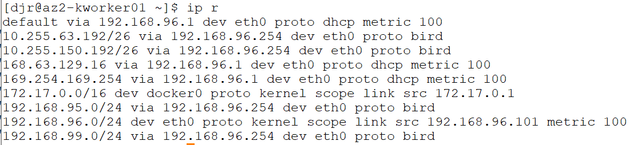


Calico BGP Routing Configuration for Demo
Key Points -
Calico does full mesh iBGP by default.
- iBGP full mesh scale issues at scale.
- iBGP full mesh requires “next-hop routes” to be present on the all the Kubernetes nodes.
Calico BGP is very flexible with several options.
- iBGP Route Reflectors
- Multiple ASNs with eBGP.
Demo BGP Setup –
Each location is a separate ASN, with an ASN for the “core”.
The SD-WAN routers are the ASN BRs.
The SD-WAN routers are fully meshed iBGP.
The Kubenetes nodes eBGP peer with the local SD-WAN router.
- No need for “next-hop routes” on the Kubernetes nodes.

Slide 19
Data Center Networking
Components -
Virtual Network running on the Hypervisor
- Could also be physical servers on a physical network
One IP Subnet for each “rack” of worker nodes.
SD-WAN router providing IPSEC connections to other location.

Slide 20
Azure Networking
Components -
One Azure VNET
Two subnets within the VNET
SD-WAN VM with two NICs
Azure Route-Table for Kube-Subnet
Key Points –
Azure is routing ALL the traffic between VMs, so an Azure route-tables must be created.
Ensure that "IP Forwarding" is enable on all the NICs of the VM, including the worker nodes.
Network Security Groups (attached to NICs or subnets) must be updated if in use.

Slide 21
AWS Networking
Components -
One AWS VPC
Two subnets within the VNET
SD-WAN VM with one NICs
AWS Route-tables for Kube-Subnet & SD-WAN Network
Key Points –
AWS is routing ALL the traffic between VMs (even on different subnets), so AWS route-tables must be created.
Ensure that “Source/Dest Checking" is disabled on all the NICs of the VM, including the worker nodes.
Security Groups (attached to NICs) must be updated if in use.

Slide 22
Questions… Comments… Concerns…

